Slide 1
BA CUSTOMERS PREDICTIONS

Slide 2
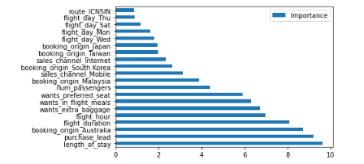
- The most important variables in the model is length of stay, which is number of days spent at destination and purchase lead, which is number of days between departure and booking.
FEATURE IMPORTANCES
- Information about flight such as flight hour and duration was also important important. Although, information about the routes was not important.
- The accuracy of the model for the positives is 0.29 (precision) and 0.63 (recall). The model needs more improvements. I suggest consider leveraging additional data points or features that can help improve the precision of the predictions.

